Slide 1

Geometry
Unit 6, Lesson 1 Dilations Volume 1, pg. 285

Slide 2


Benchmark
MA.912.GR.2.1
Given a preimage and image, describe the transformation and represent the transformation algebraically using coordinates.
volume 1, pg. 285

Slide 3
Integrated Mathematical Thinking and Reasoning Standards
MA.K12.MTR.1.1 Actively participate in effortful learning both individually and collectively.
MA.K12.MTR.2.1 Demonstrate understanding by representing problems in multiple ways.
MA.K12.MTR.4.1 Engage in discussions that reflect on the mathematical thinking of self and others.
volume 1, pg. 285

Slide 4

Learning Targets
I can write an algebraic description using coordinate notation of a dilation on a coordinate plane.
I can describe a dilation by giving the scale factor and center of dilation.
volume 1, pg. 285

Slide 5

Warm-Up
volume 1, pg. 285

Slide 6
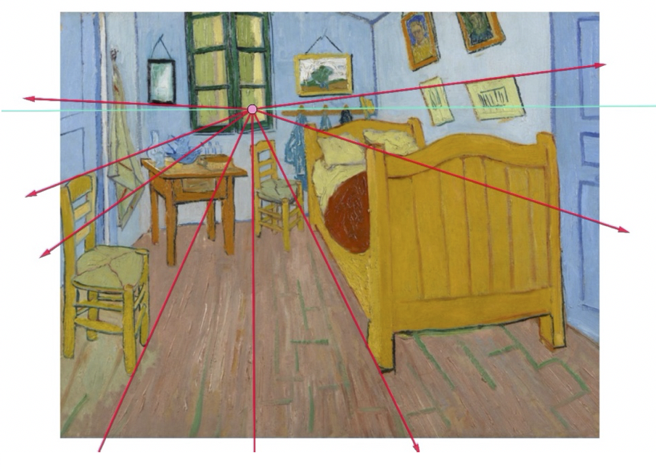
6.1.1 Warm-Up: What is Your Perspective
Point perspective is a common method of drawing a three-dimensional object onto a two-dimensional plane. The artist chooses one point from which everything in the drawing is set. It was first discovered during the Renaissance. An example of a painting that uses point perspective is Vincent van Gogh’s Vincent's Bedroom in Arles.
volume 1, pg. 285

Slide 7
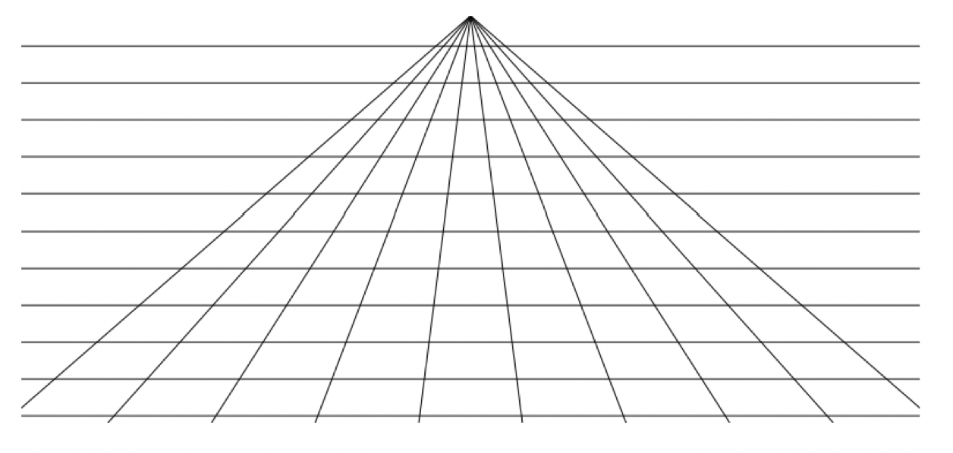
Use the grid to sketch a rectangle that is close to the point of perspective and a rectangle that is farther away from the point of perspective.
volume 1, pg. 285

Slide 8

Refresher
volume 1, pg. 286

Slide 9

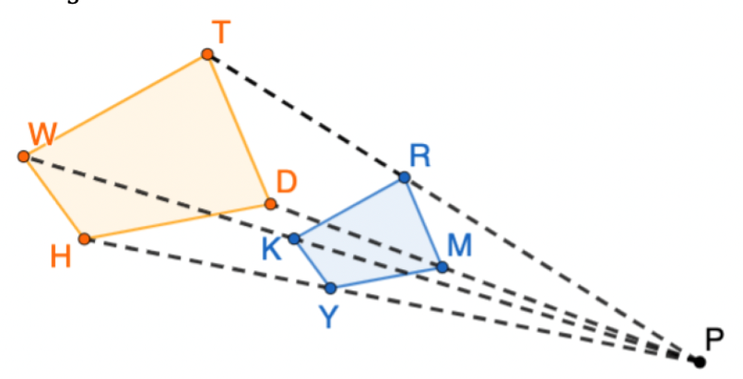
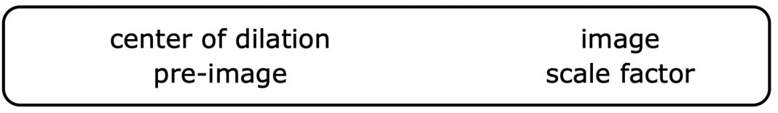
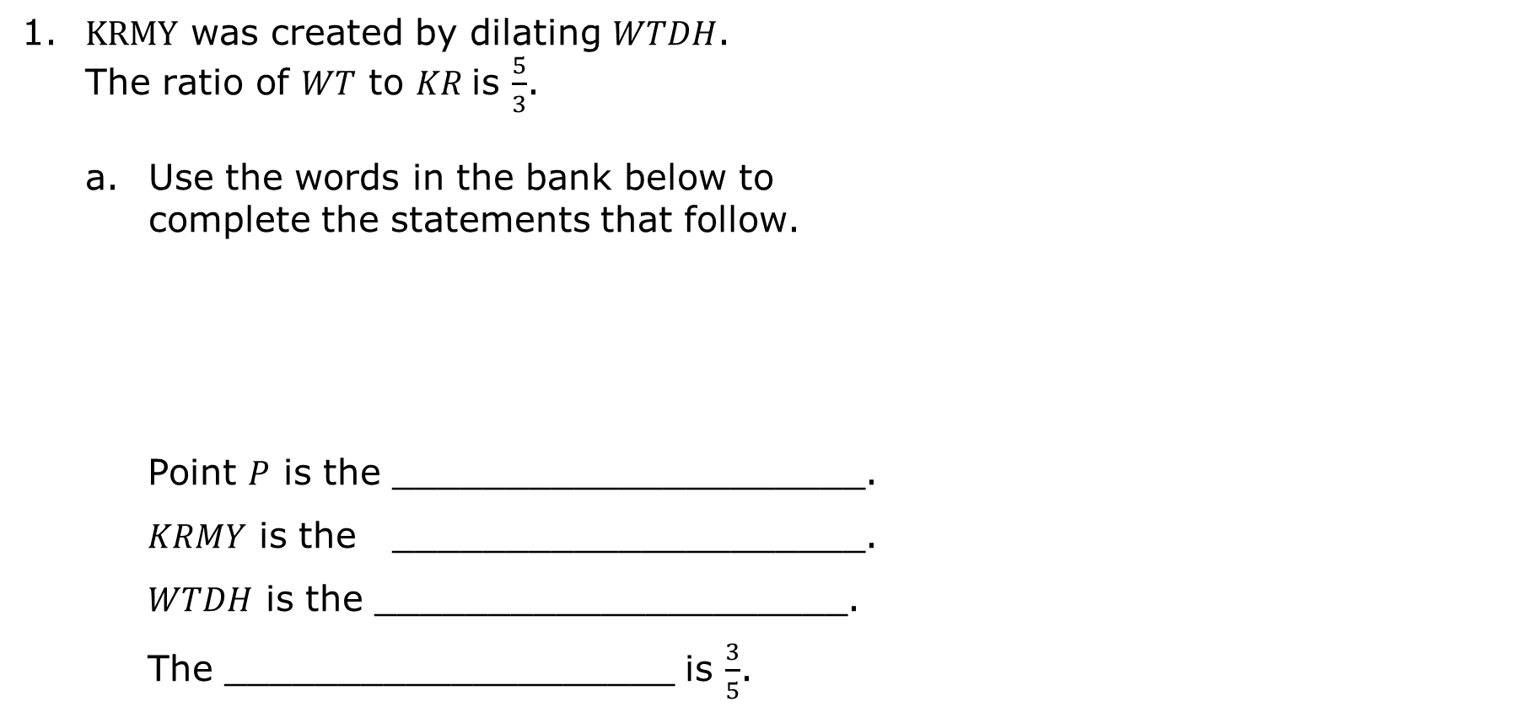
6.1.2 Refresher: Dilations
1. $KRMY$ was created by dilating $WTDH$. The ratio of $WT$ to $KR$is $\frac{5}{3}$.
Use the words in the bank below to complete the statements that follow.
Point $P$ is the _____________________.
$KRMY$ is the _____________________.
$WTDH$ is the _____________________.
The ____________________ is $\frac{3}{5}$.
volume 1, pg. 286

Slide 10

Use the diagram to determine each.
What is the ratio of $\frac{WH}{KY}$?
What is the ratio of $\frac{PR}{RT}$?
volume 1, pg. 286

Slide 11

Collaboration
volume 1, pg. 286

Slide 12

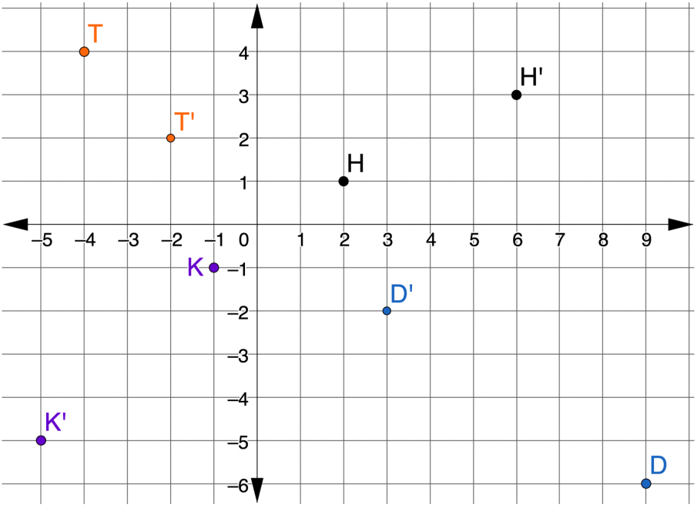
6.1.3 Collaboration: Algebraic Description of a Dilation
Points $D$, $H$, $K$, and $T$ are shown on the coordinate grid. Each point has been dilated using $\left(0, 0\right)$ as the center of dilation.
volume 1, pg. 286

Slide 13
Complete the table.
Point | Ordered Pair | Ordered Pair of the Dilation | Scale Factor
D
H
K
T
volume 1, pg. 286

Slide 14

In the coordinate plane, the algebraic representation of a dilation centered at the origin is $\left(x,y\right)→\left(kx, ky\right)$, where $k$ is the scale factor.
Write the algebraic representation for each point.
Point | Algebraic Representation of Dilation
D
H
K
T
volume 1, pg. 287

Slide 15
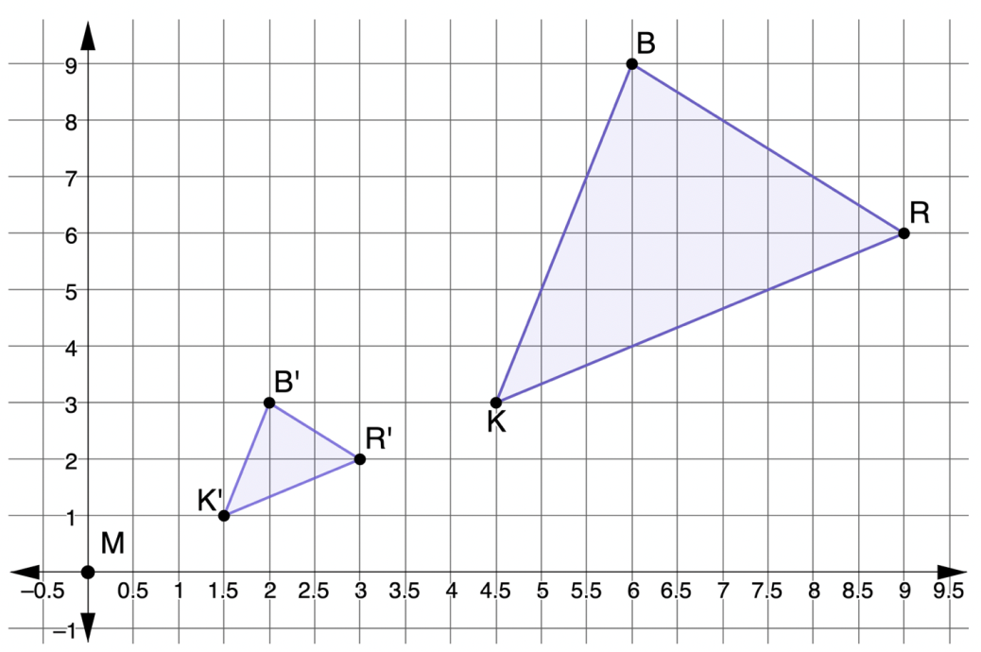

2. $∆R′B′K′$ is the result of dilating $∆RBK$ using the origin as the center of dilation.
What is the scale factor of the dilation?
volume 1, pg. 287

Slide 16
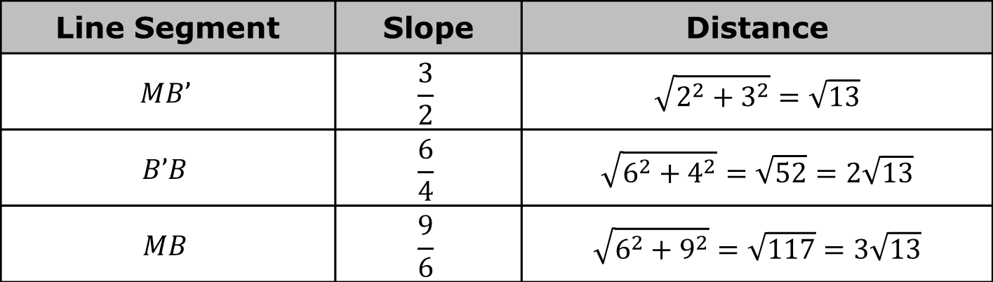
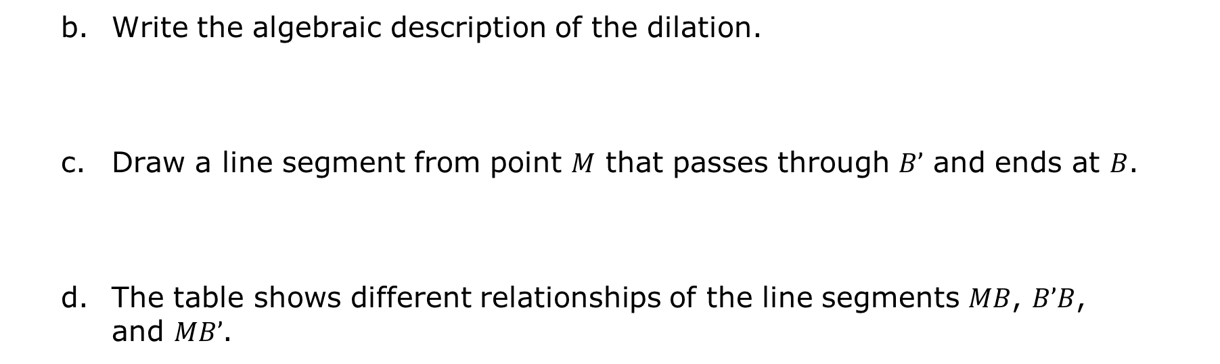
Write the algebraic description of the dilation.
Draw a line segment from point $M$ that passes through $B’$ and ends at $B$.
The table shows different relationships of the line segments $MB$, $B’B$, and $MB’$.
Line Segment | Slope | Distance
$$MB’$$ | $$\frac{3}{2}$$ | $$\sqrt{2^{2}+3^{2}}=\sqrt{13}$$
$$B’B$$ | $$\frac{6}{4}$$ | $$\sqrt{6^{2}+4^{2}}=\sqrt{52}=2\sqrt{13}$$
$$MB$$ | $$\frac{9}{6}$$ | $$\sqrt{6^{2}+9^{2}}=\sqrt{117}=3\sqrt{13}$$
volume 1, pg. 287

Slide 17
Discuss with your partner how the scale factor could be determined using slope. Summarize your discussion.
Discuss with your partner how the scale factor could be determined using distance.
volume 1, pg. 287

Slide 18

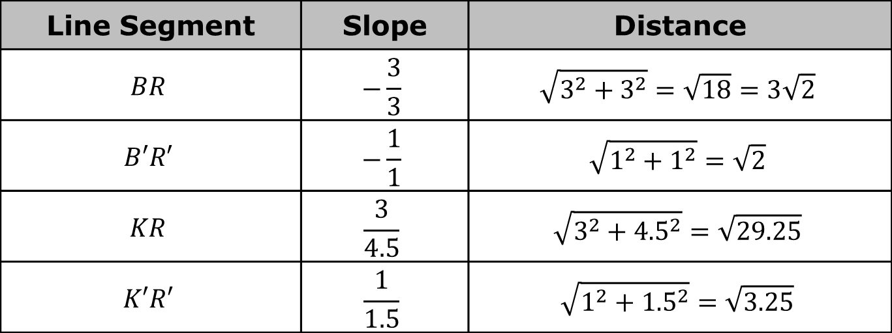
The table shows different relationships among the line segments $BR$, $B′R′$, $KR$ and $K′R′$.
Discuss with your partner how the scale factor is also found in the relationships between the slopes of $BR$ and $B′R′$, and $KR$ and $K′R′$. Write a summary of the relationships.
Line Segment | Slope | Distance
$$BR$$ | $$−\frac{3}{3}$$ | $$\sqrt{3^{2}+3^{2}}=\sqrt{18}=3\sqrt{2}$$
$$B′R′$$ | $$−\frac{1}{1}$$ | $$\sqrt{1^{2}+1^{2}}=\sqrt{2}$$
$$KR$$ | $$\frac{3}{4.5}$$ | $$\sqrt{3^{2}+{4.5}^{2}}=\sqrt{29.25}$$
$$K′R′$$ | $$\frac{1}{1.5}$$ | $$\sqrt{1^{2}+{1.5}^{2}}=\sqrt{3.25}$$
volume 1, pg. 288

Slide 19

Guided Instruction
volume 1, pg. 288

Slide 20
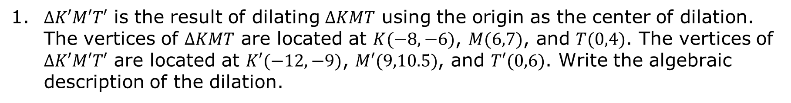
6.1.4 Guided Instruction: Describing Dilations
1. $∆K′M′T′$ is the result of dilating $∆KMT$ using the origin as the center of dilation. The vertices of $∆KMT$ are located at $K(−8,−6)$, $M(6,7)$, and $T(0,4)$. The vertices of $∆K′M′T′$ are located at $K′(−12,−9)$, $M′(9,10.5)$, and $T′(0,6)$. Write the algebraic description of the dilation.
volume 1, pg. 288

Slide 21
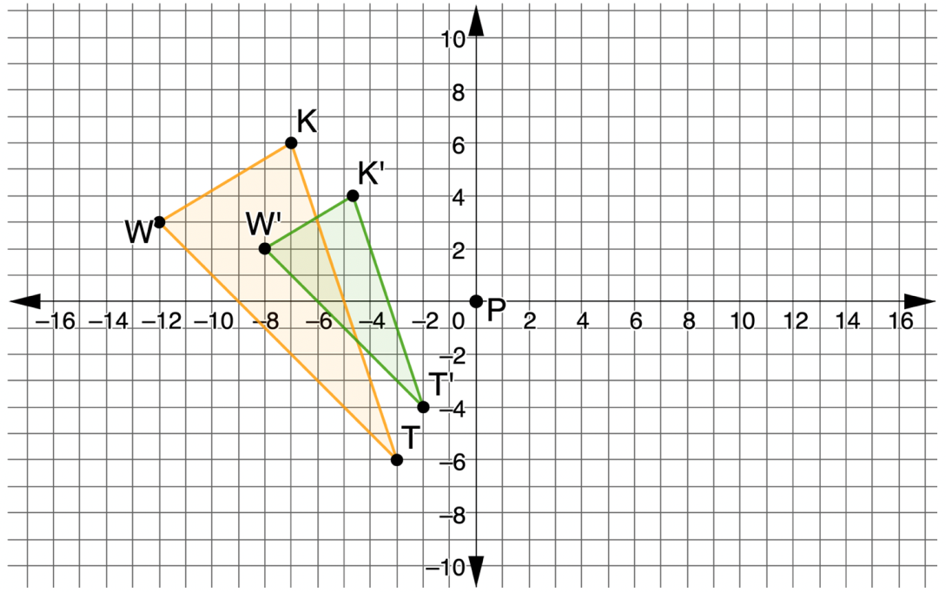

Triangles $TWK$ and $T′W′K′$ are shown on the coordinate grid, where $∆T′W′K′$ is a dilation of $∆TWK$ and point $P$ is the center of dilation.
Show the dilation on the coordinate grid by drawing dotted lines from the center of dilation through each vertex.
volume 1, pg. 288

Slide 22
What is the scale factor of the dilation?
Write the algebraic description of the dilation.
volume 1, pg. 289

Slide 23
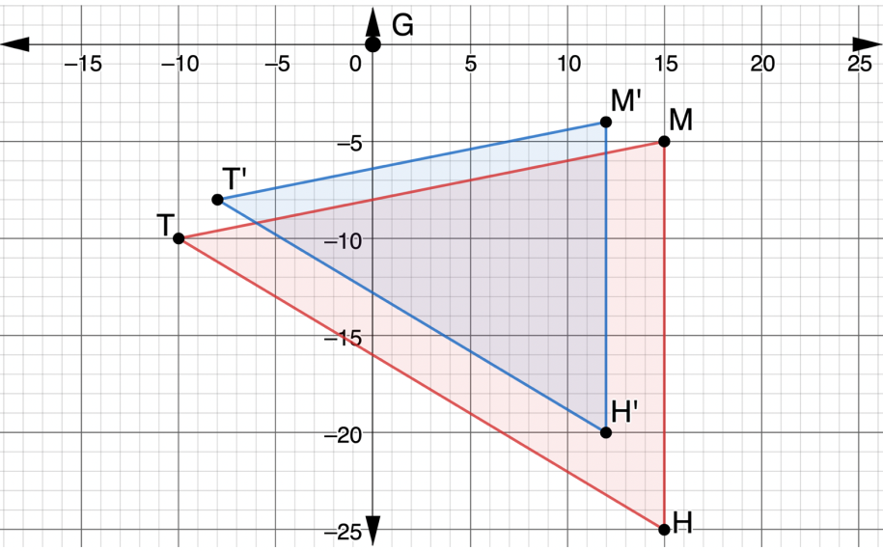

Triangles $THM$ and $T′H′M′$ are shown on the coordinate grid, where $∆T′H′M′ ′$ is a dilation of $∆THM$.
Write a description of the dilation by giving the center of dilation and the scale factor.
volume 1, pg. 289

Slide 24

Guided Practice
volume 1, pg. 289

Slide 25

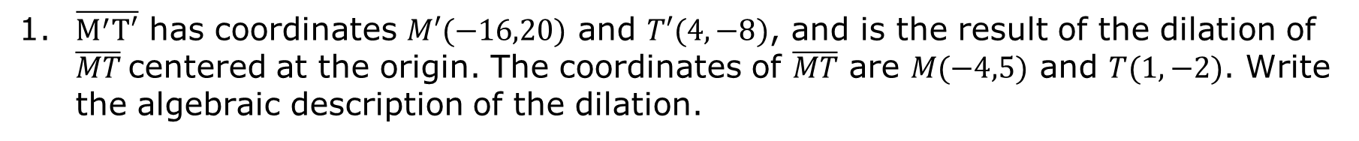
6.1.5 Guided Practice: Describing Dilations
1. $\overline{M^{′}T′}$ has coordinates $M′(−16,20)$ and $T′(4,−8)$, and is the result of the dilation of $\overline{MT}$centered at the origin. The coordinates of $\overline{MT}$ are $M(−4,5)$ and $T(1,−2)$. Write the algebraic description of the dilation.
volume 1, pg. 289

Slide 26
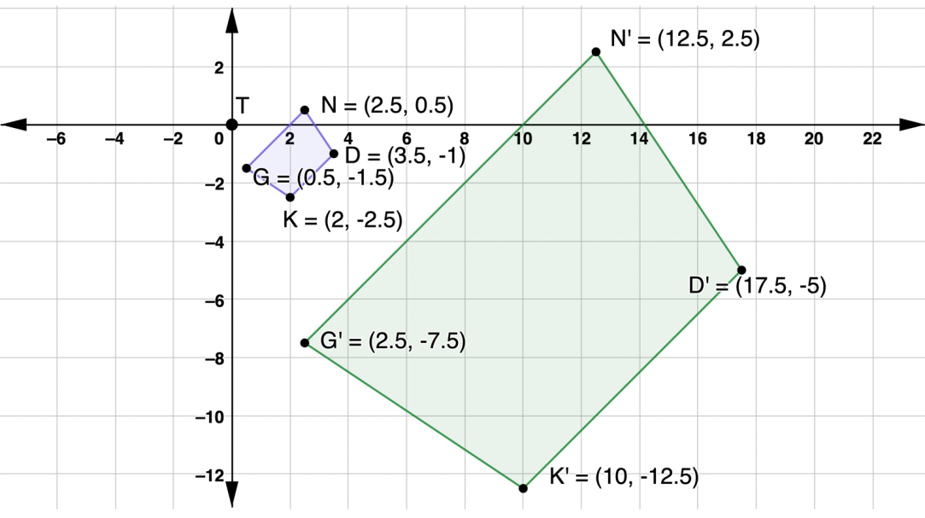

2. $NDKG$ and $N′D′K′G$’ are shown on the coordinate grid, where $N′D′K′G’$ is a dilation of $NDKG$.
Write a description of the dilation by giving the center of dilation and the scale factor.
volume 1, pg. 289

Slide 27

Wrap-Up
volume 1, pg. 290

Slide 28
6.1.6 Wrap-Up: Cool Down
Explain how dilations are different from rigid transformations, in your own words.
volume 1, pg. 290

